Slide 1
Business Analytics
[ ]
Progress
( Prediction of Integration
And Abolition for University )
17102044 Jeewon Kim
18102085 Byungchan Lee
20102125 Yujin Pi

Slide 2



contents
1. Data
2. EDA & Goal
3. Plan

Slide 3

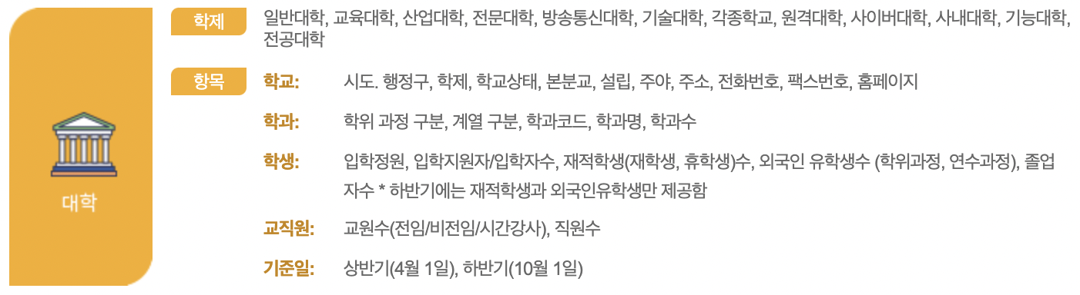
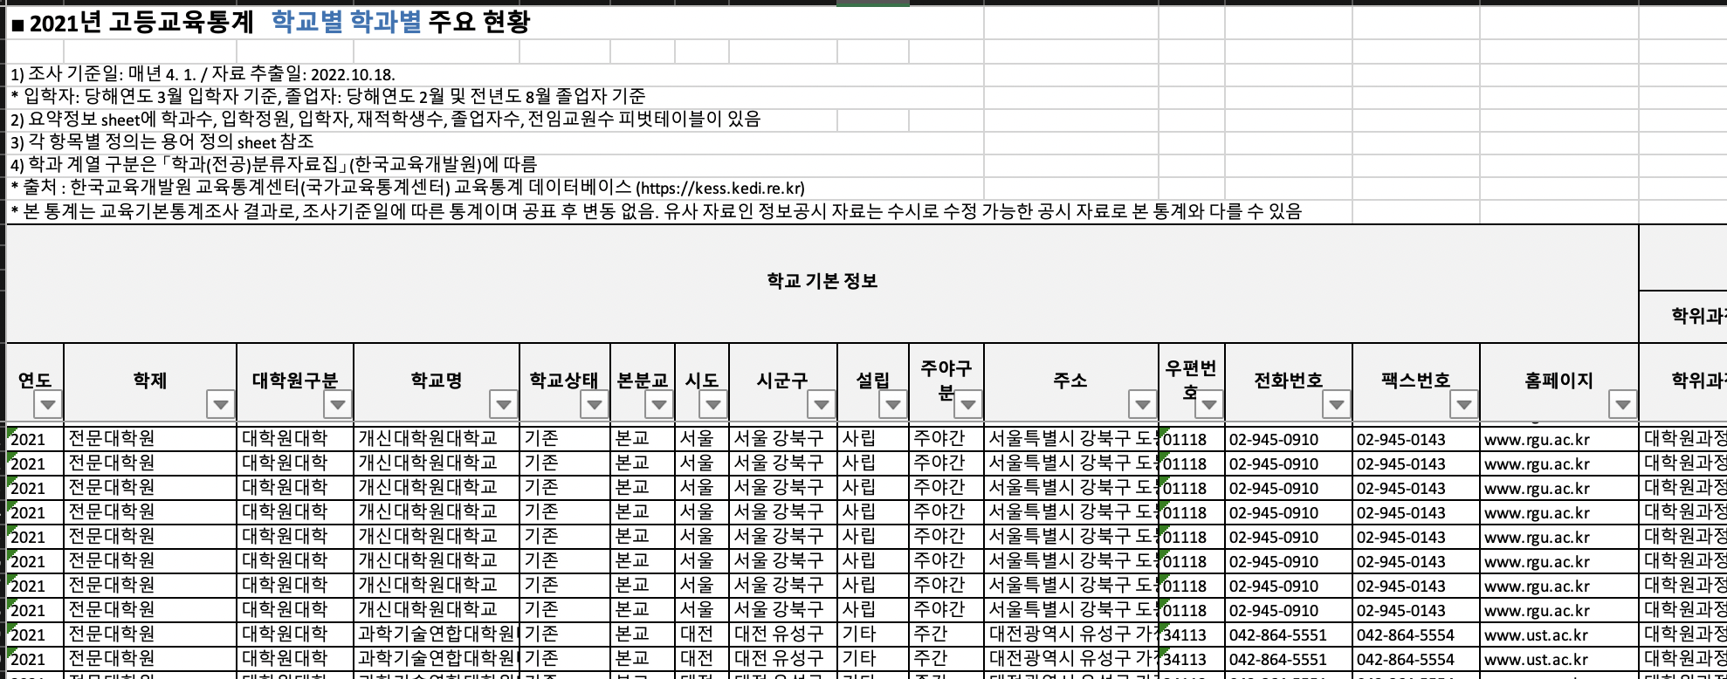
Part 1
Data
Data Source : Korean Educational Statistics Service
- (Main Dataset) Dataset by school and department
- Purpose : To obtain data on admission by school and department

Slide 4
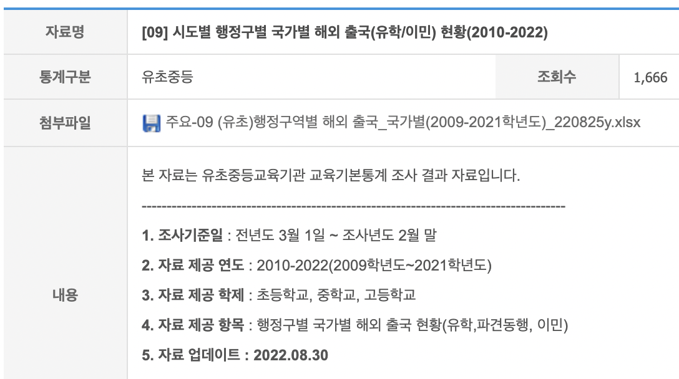
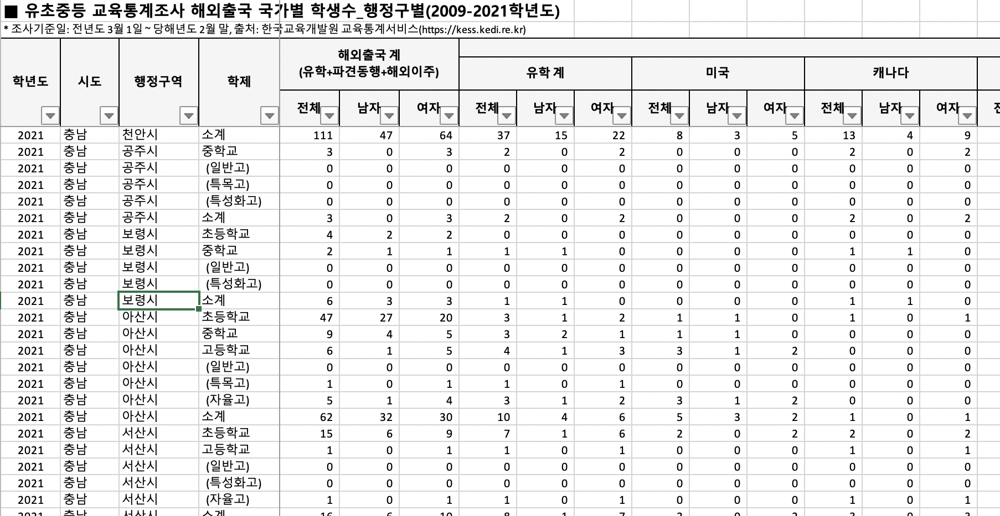
Part 1
Data
Data Source : Korean Educational Statistics Service
Status of overseas departures (studying/immigration) by country by administrative district by city and province
Purpose : To obtain population data flowing out of the country

Slide 5

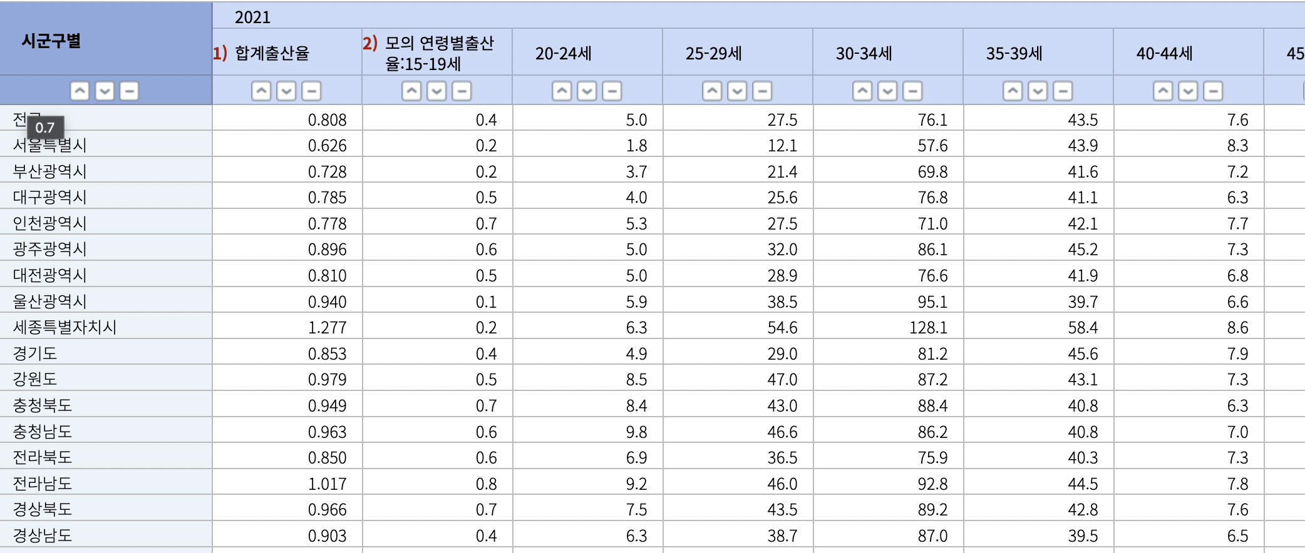
Part 1
Data
Data Source : Korean Statistical Information Service
Total Fertility rate by region, expected fertility rate by age
Purpose : To obtain fertility rate by region

Slide 6
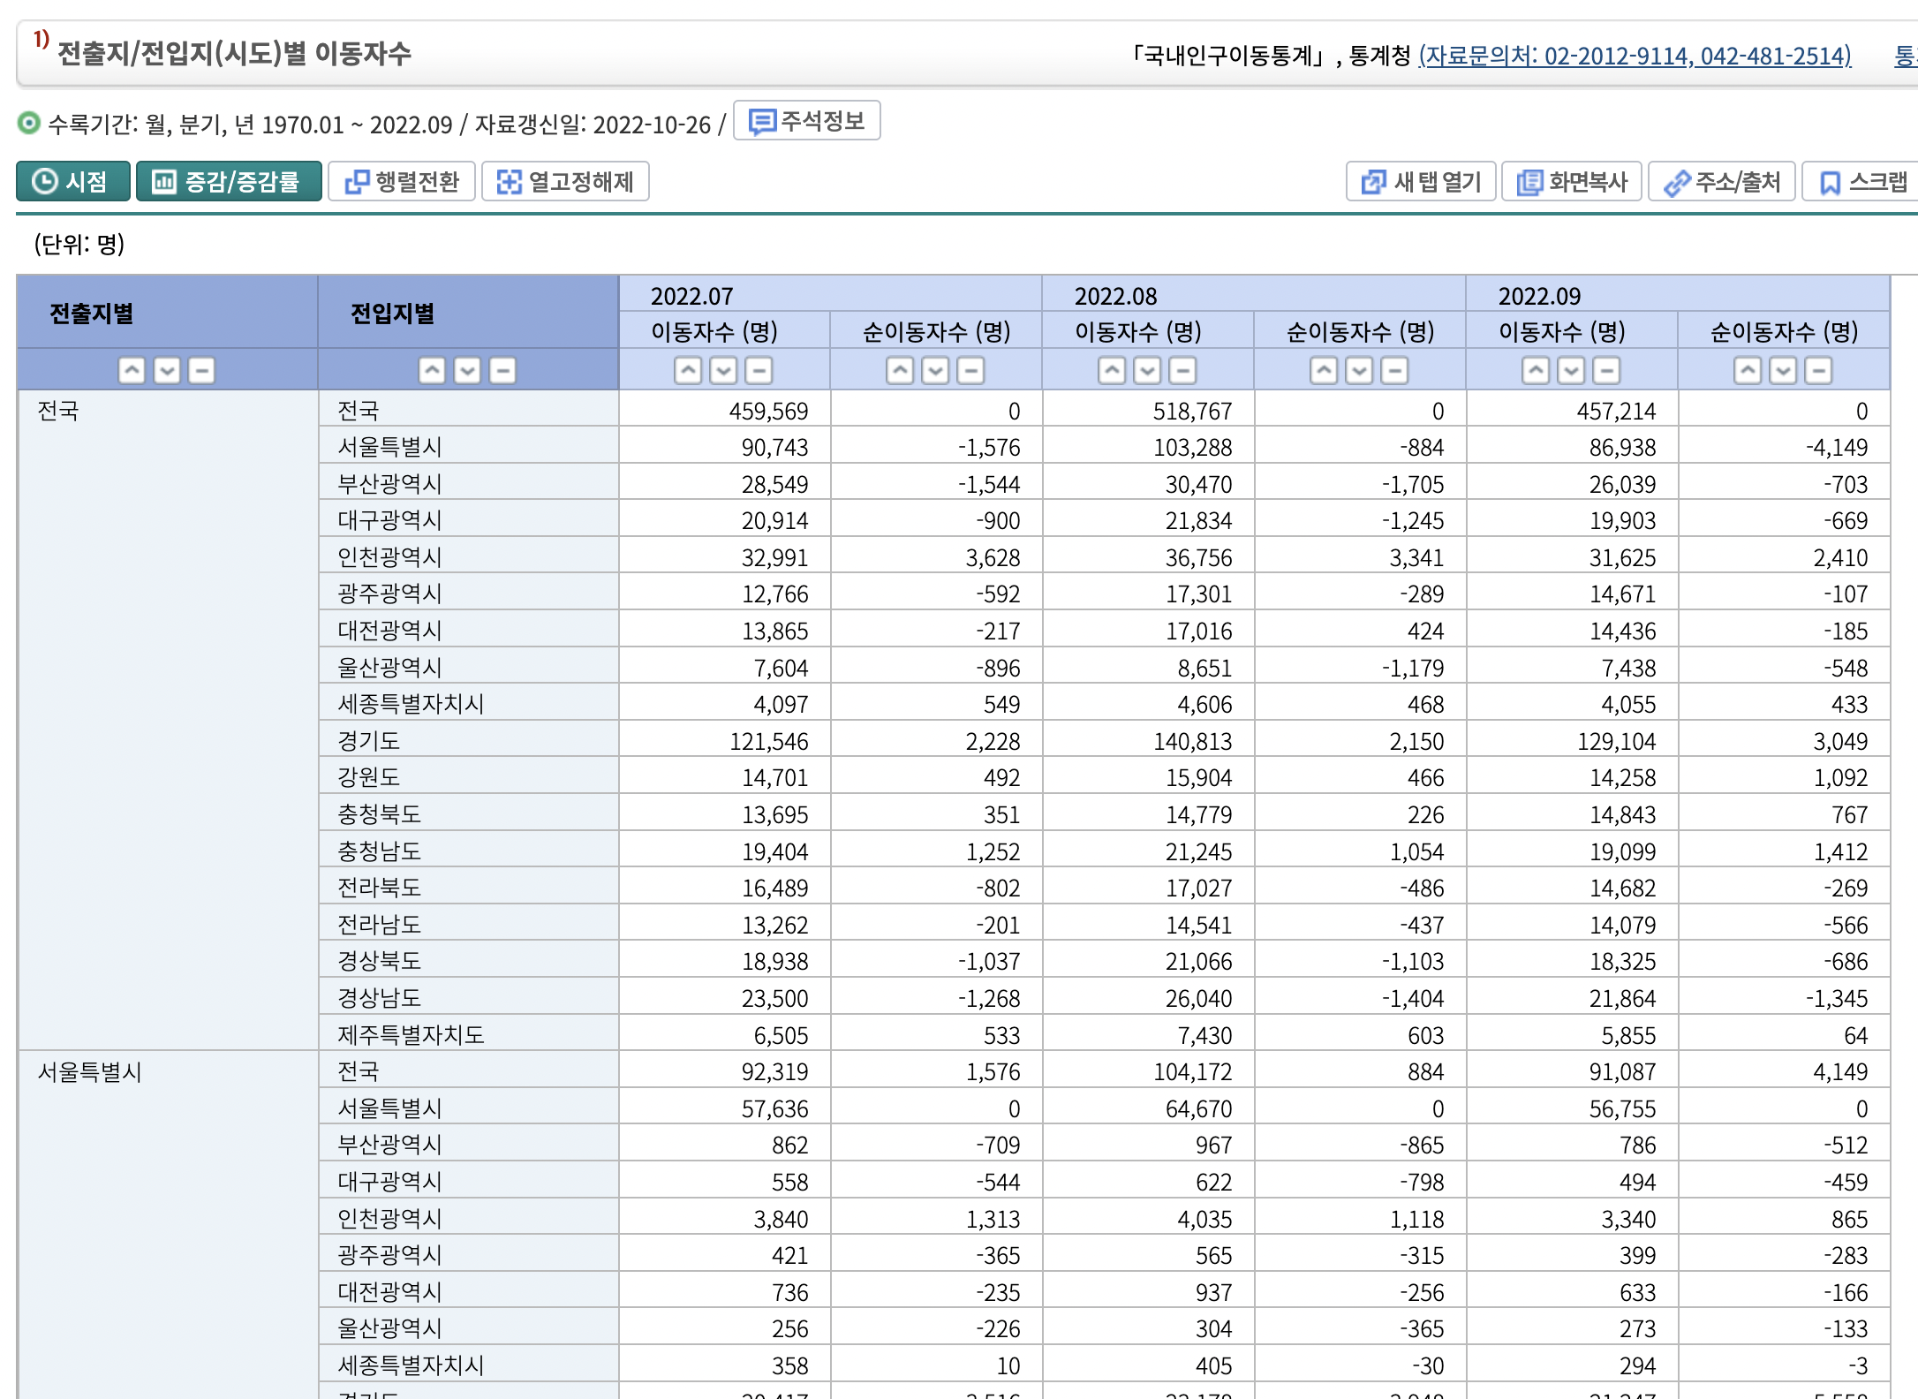
Part 1
Data
Data Source : Korean Statistical Information Service
The number of people moving in and moving out by region
To obtain net movers by region

Slide 7

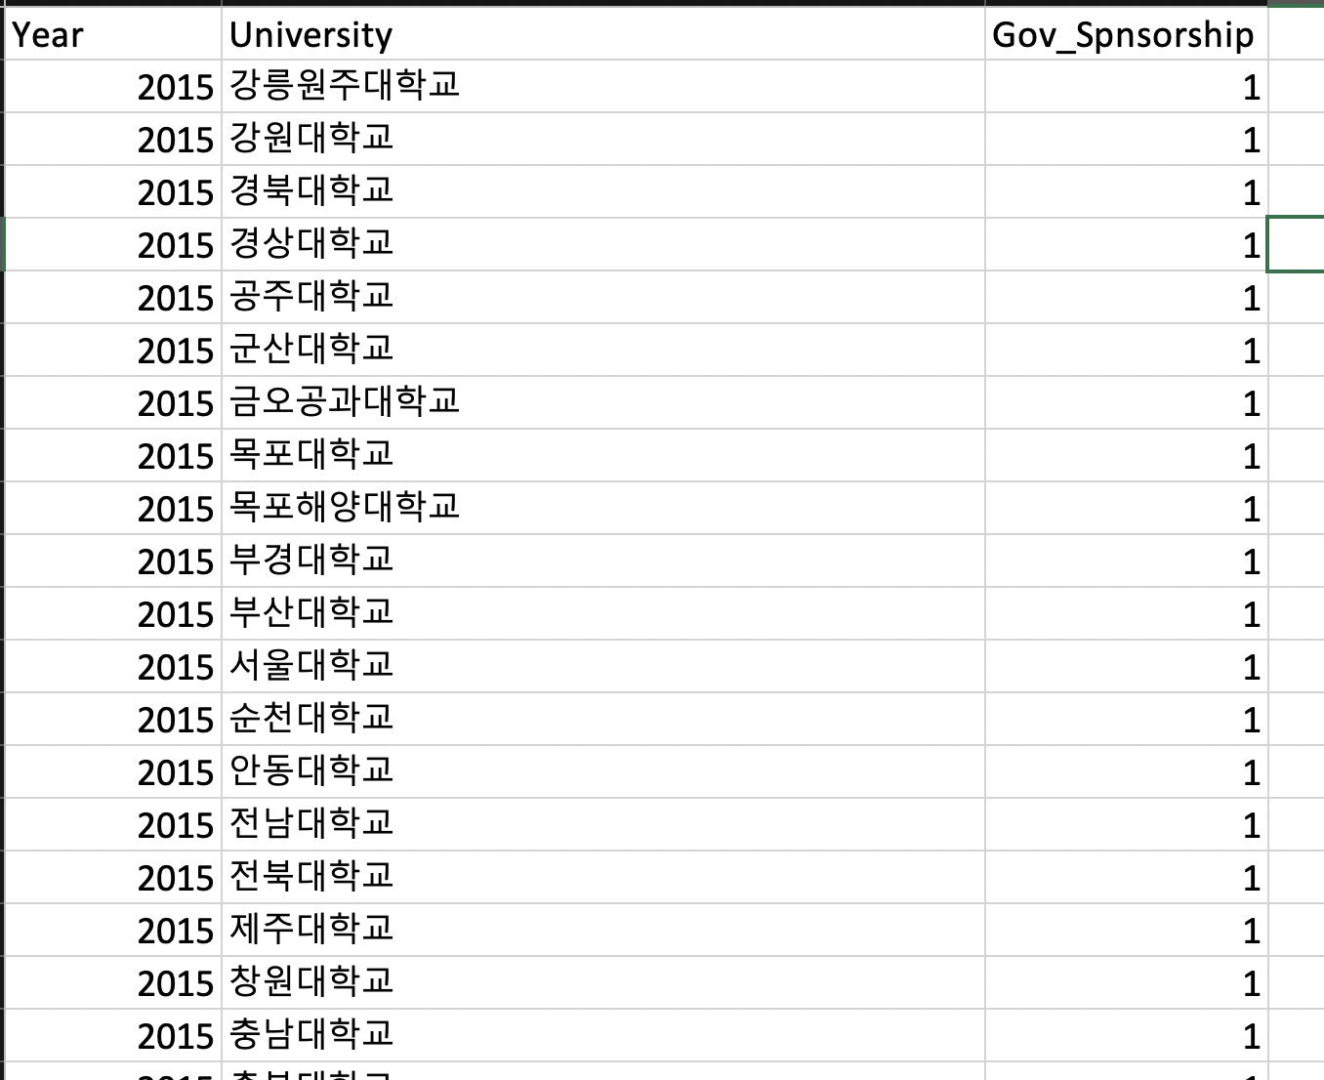
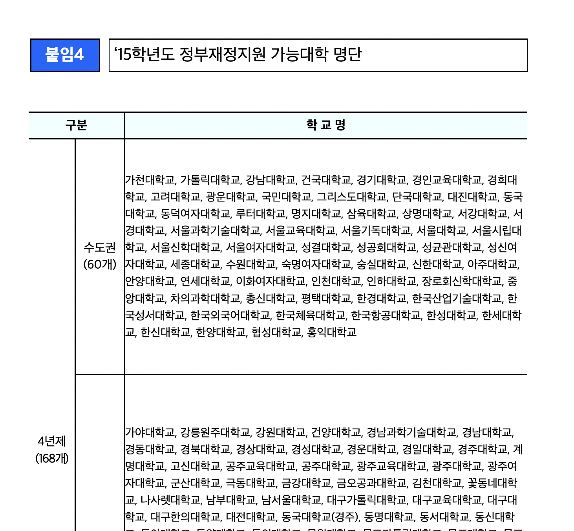
Part 1
Data
Data Source : Ministry of Education
The availability of government financial support by school
Purpose : To check whether schools on the main dataset are available for government financial support

Slide 8
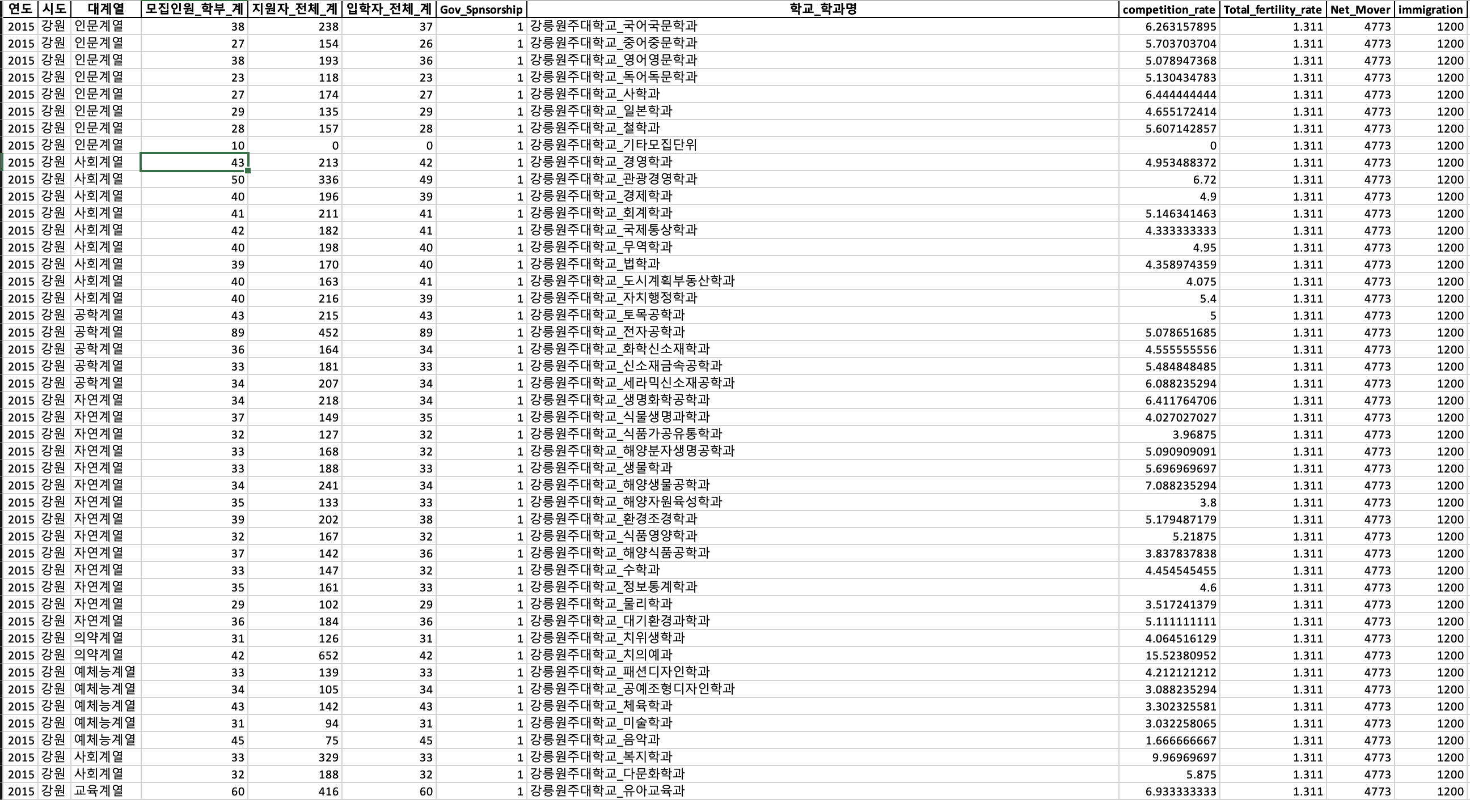
Part 1
Data
Final Dataset
46,474 Instances

Slide 9
Part 1
Data
Column explanation
Year : Year information for each admission
Region : Region information for each school
Departmental Affiliation : A major classification of departmental affiliations
The number to be admitted : Information on students admitted by departments
Candidate : The number of candidates
The number of admissions : Information on students who admitted
Government financial support
- 1 : Existence of government financial support
- 0 : No existence of government financial support

Slide 10
Part 1
Data
Column explanation
8. School & Department : Information merged on school and each department
9. Competition rate : Information derived from dividing the number of applicants by the number to be admitted
10. Total fertility rate : Information on fertility rate by each region
11. Net mover : Information on net mover by each region
12. Immigration : Information on the number of immigration

Slide 11
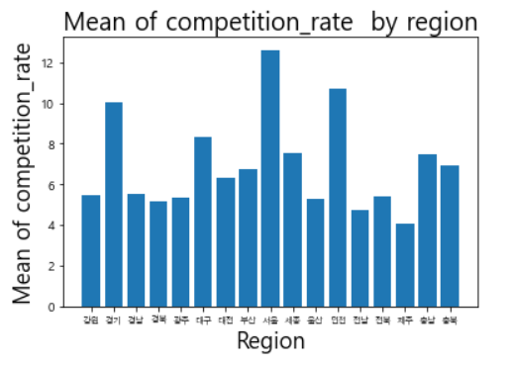
Part 2
EDA & Goal
Exploration of our dataset with visualization
Mean of competition rate by region
So called “수도권”, capital areas including Seoul, Incheon, and Gyeonggi, showed high competition rate compared to other regions.

Slide 12
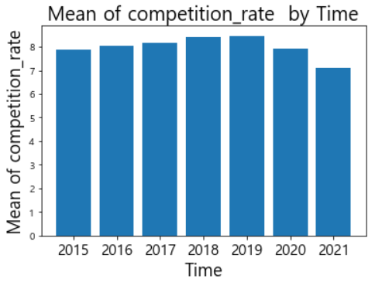
Part 2
EDA & Goal
Exploration of our dataset with visualization
Mean of competition rate by time
As time flew, the mean of competition rate generally showed a trend of decreasing.

Slide 13
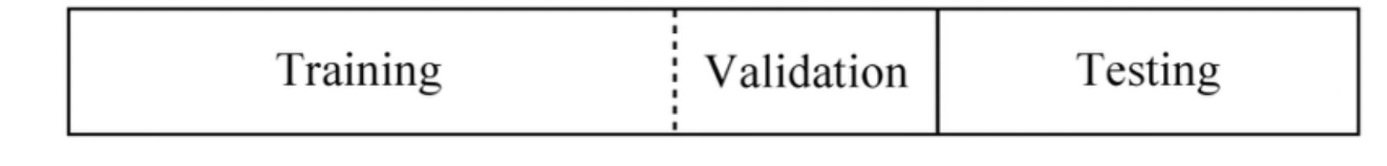
Part 2
EDA & Goal
Data distribution
2015~2019 Years Data
2020~2021 Years Data

Slide 14
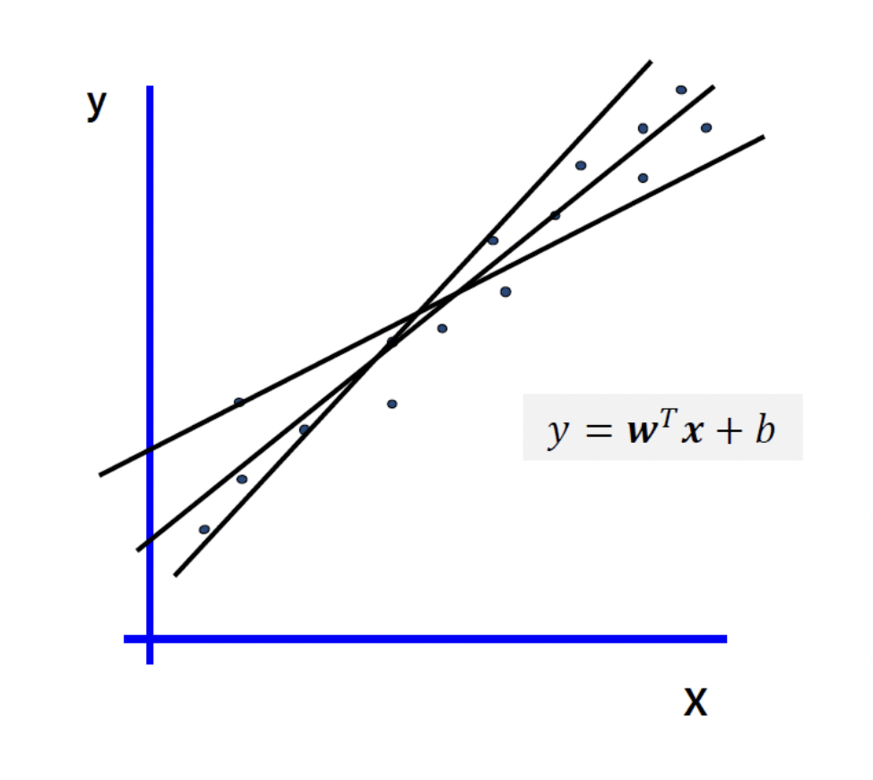
Part 2
EDA & Goal
Goal from model training
Target variable
Linear Regression Model
Instance : School and department
Features : Year, Region, Departmental Affiliation, The number to be admitted, The number of admissions, Government financial support, Total fertility rate, Net mover, Immigration
Target : The number of candidates
The number of candidates

Slide 15
Part 2
EDA & Goal
Evaluation Measure of the project
Derived Features
Competition Rate
Derived feature from dividing the number of applicants by the number to be admitted

Slide 16
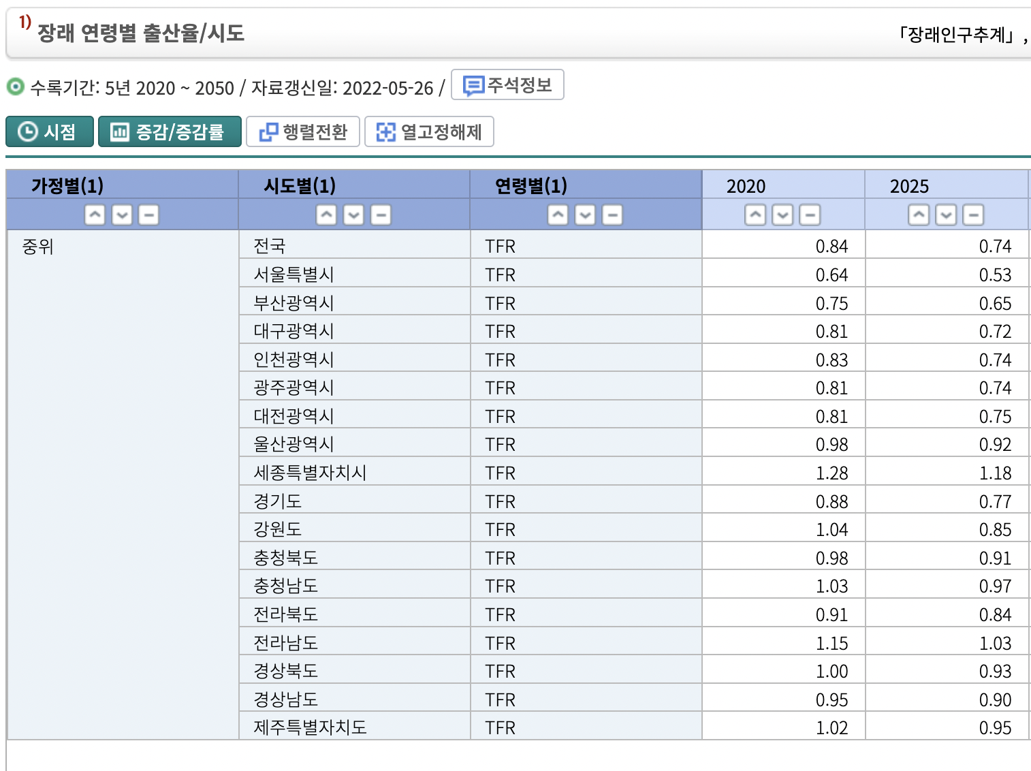
Part 3
Plan
Applying Feedback
2. Using pipeline for model training
Preprocessing
Automatic Model Selection
Reinforcing our model
3. Predicting future
- Collecting future features
ex) Future predicted fertility rate
Applying on our model
4. Visualization

Slide 17
Part 3
Plan
Date | Progress | Note
Nov 1 | Proposal Presentation | 1st Presentation
Nov 8 | Collect & Preprocess Data
Nov 15 | EDA, Prepare 2nd Presentation | 2nd Presentation
Nov 22 | Model Training
Nov 29 | Model Validation
Dec 6 | Visualization, Prepare 3rd Presentation | 3rd Presentation

Slide 18
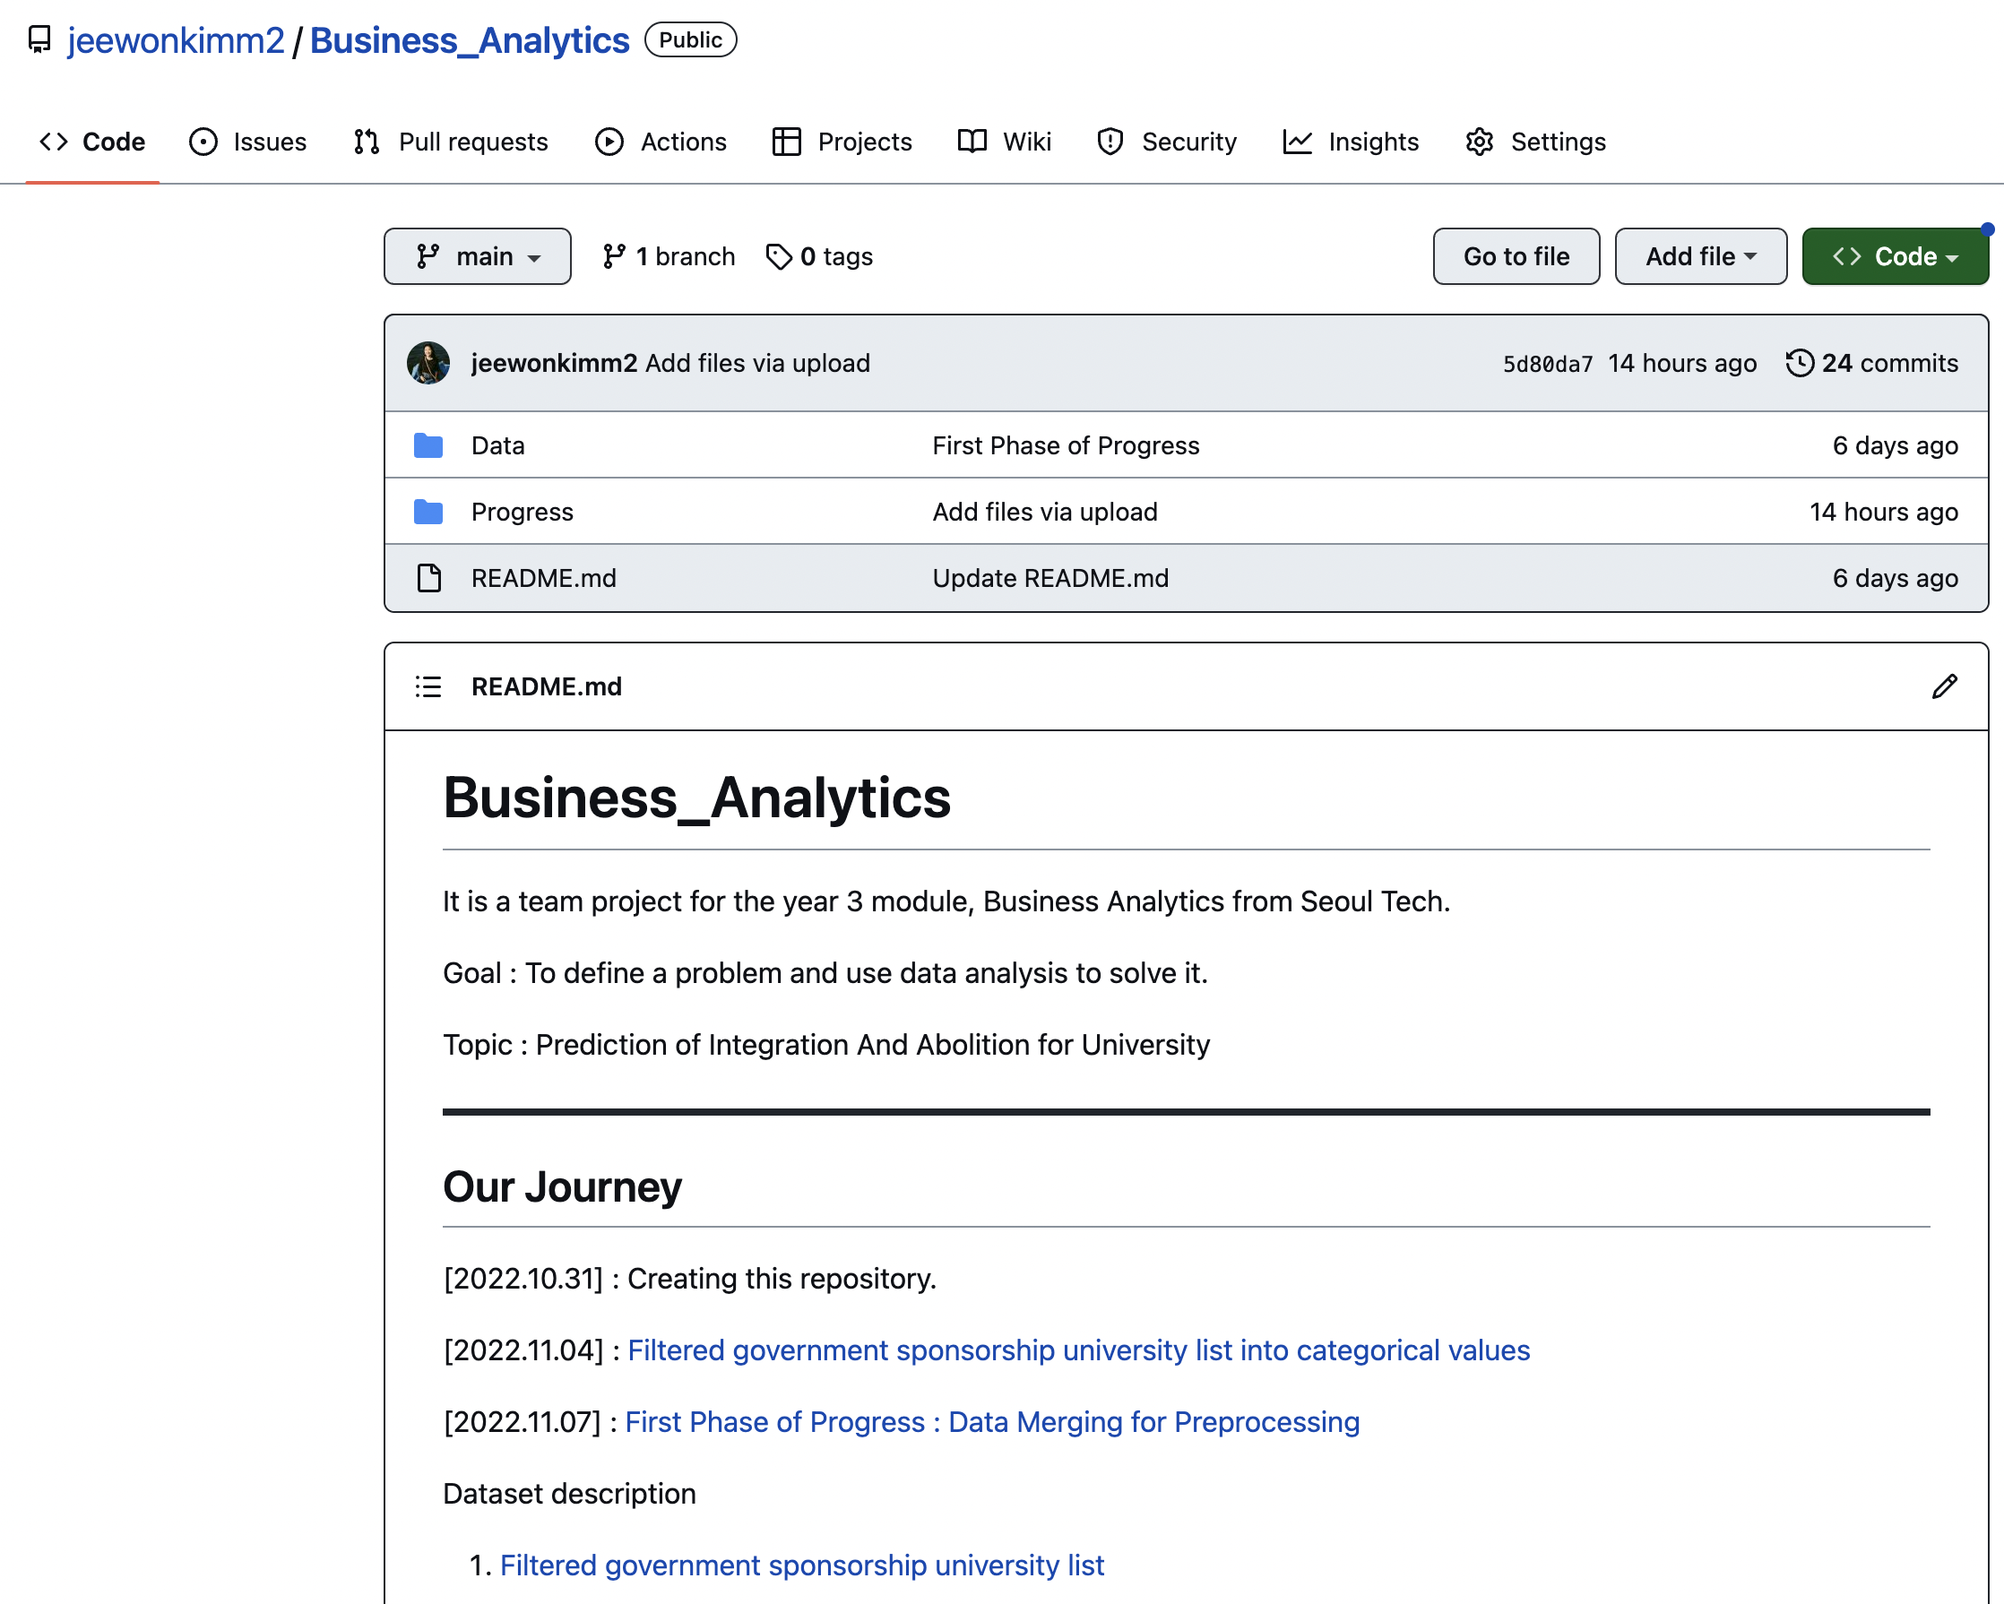
Part 3
Plan
Git Repository : https://github.com/jeewonkimm2/Business_Analytics

Slide 19
Reference
https://kess.kedi.re.kr/contents/dataset?itemCode=04&menuId=m_02_04_03_02&tabId=m2
https://kess.kedi.re.kr/post/6695774?code=&words=&since=&until=&page=1&itemCode=04&menuId=m_02_04_03_01
https://kosis.kr/search/search.do?query=%ED%95%A9%EA%B3%84%EC%B6%9C%EC%82%B0%EC%9C%A8
https://kosis.kr/statHtml/statHtml.do?orgId=101&tblId=DT_1B26003_A01&vw_cd=MT_ZTITLE&list_id=A_1&seqNo=&lang_mode=ko&language=kor&obj_var_id=&itm_id=&conn_path=MT_ZTITLE

Slide 20
Business Analytics
[ ]
Thank you
☺

